Slide 1

An effective text summarization using natural language processing
ADITYA ENGINEERING COLLEGE
Under guidance of
B.R.S.S.Raju, MCA, M.Tech
Asst.Prof
Presented by,
Aparna Alamanda (16A91A05C4)
Himasri Satthi (16A91A05H0)
Sai Pradeep Boddu(16A91A05C7)
Nagendra Tetakale (16A91A05H5)

Slide 2
abstract
Text Summarization is a technique that shortens a long piece of text in internet with main points outlined that gives an idea of the whole content. It becomes critical when someone needs a quick and accurate summary of very long content. Summarizing text can be expensive and time-consuming if done manually.
Natural Language Processing is helpful in creating an automatic text summary and web scrapping is helpful to extract data from websites in internet.

Slide 3
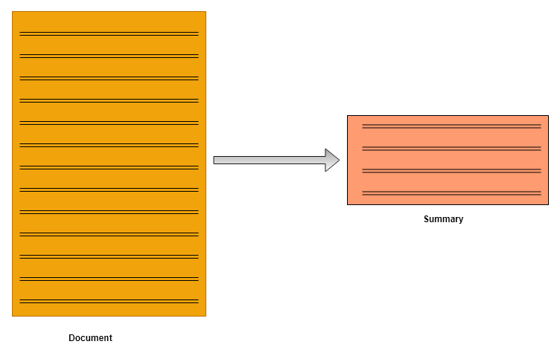
Continution…

Slide 4
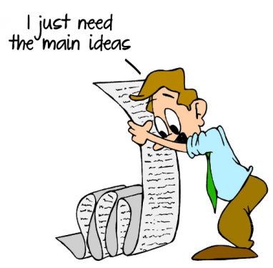
Existing system
Internet contain huge amount of information which may be redundant or insignificant to users. Users have to go through the content of every website manually, put in a lot of effort to understand and summarize it in their own words.

Slide 5
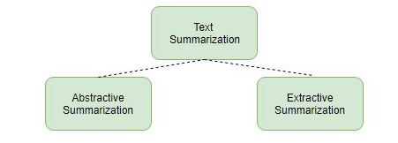
Proposed system
The proposed system of text summarization technique enhances the readability of text in internet websites and reduces the time spent in researching for information
This system makes use of two approaches to summarize texts:
-Extractive summarization
-Abstractive summarization

Slide 6
continuation
Extractive summarization:
In this, a subset of words that represent most important points is pulled from a text document and combined to make a summary

Slide 7
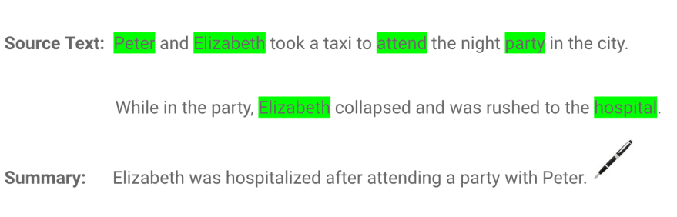
continuation
Abstractive summarization:
In abstractive summarization is applied to paraphrase and shorten the original document, just like humans do. can generate new phrases and sentences that represent the most important information from the source text without grammatical inaccuracies.

Slide 8
System configuration
HARDWARE REQUIREMENTS:
Processor - Intel Pentium-II or higher
RAM - 128MB or higher
Hard Disk - 20GB or higher
Key Board - Standard Windows Keyboard
Mouse - Two or Three Button Mouse
Monitor - LCD/LED
SOFTWARE REQUIREMENTS:
Operating System - Windows XP or higher
Coding Language - Python(v 3.8)
Technology - Machine Learning and Natural Language processing

Slide 9




Packages

Slide 10
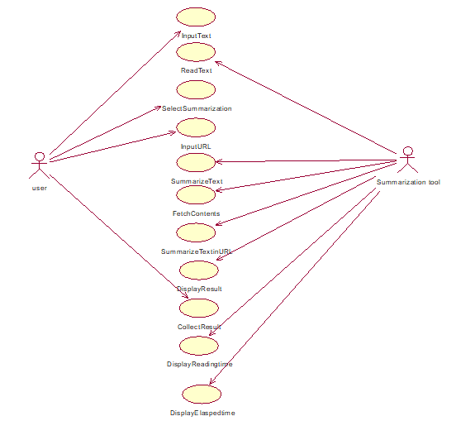
use case diagram

Slide 11
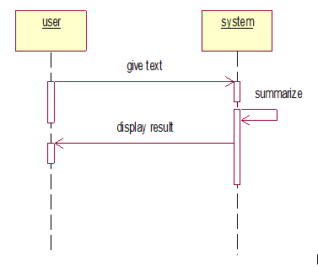
Sequence diagram
Sequence diagram to summarize text given.

Slide 12
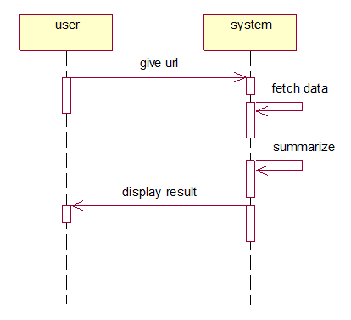
Sequence diagram
Sequence diagram to summarize text in the website of given url.

Slide 13
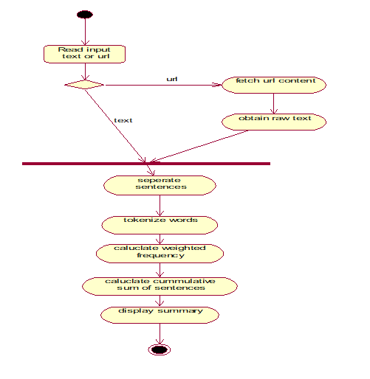
Activity diagram

Slide 14
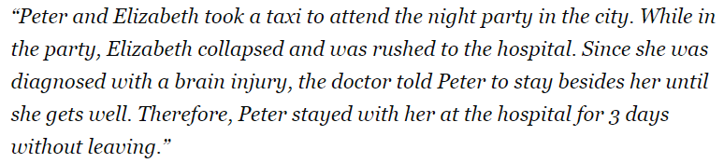
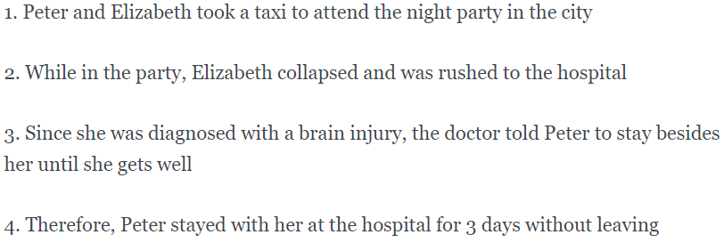
text summarization algorithm
Convert the paragraph into sentences.

Slide 15
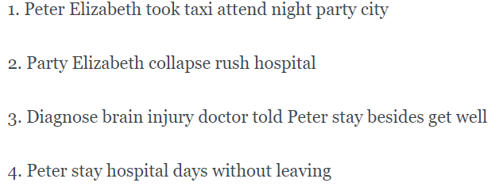
continuation
2. Process the text by removing stop words.

Slide 16
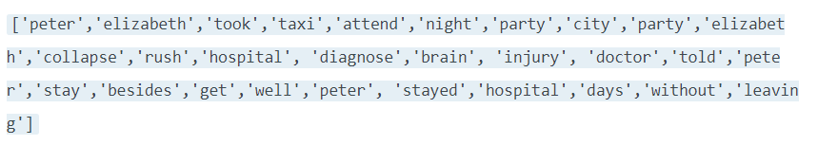
continuation
Tokenize the sentences to get all the words present in the sentences.

Slide 17
CONTINUATION
WORD | FREQUENCY | WEIGHTED FREQUENCY
peter | 3 | 1
elizabeth | 2 | 0.67
took | 1 | 0.33
taxi | 1 | 0.33
attend | 1 | 0.33
night | 1 | 0.33
party | 2 | 0.67
city | 1 | 0.33
collapse | 1 | 0.33
rush | 1 | 0.33
hospital | 2 | 0.67
diagnose | 1 | 0.33
brain | 1 | 0.33
injury | 1 | 0.33
doctor | 1 | 0.33
told | 1 | 0.33
stay | 2 | 0.67
besides | 1 | 0.33
get | 1 | 0.33
well | 1 | 0.33
days | 1 | 0.33
without | 1 | 0.33
leaving | 1 | 0.33
Evaluate weighted frequency of each word based on it’s occurrence.
Frequency of each word is
calculated and then
where i=1,2,3… and fm is
frequency of most repeated
word

Slide 18
CONTINUATION
Calculate cumulative sum of each sentence by
substituting the word’s weighted frequencies.
SENTENCE | ADD WEIGHTED FREQUENCIES | SUM | Sentence Weight
1 | Peter and Elizabeth took a taxi to attend the night party in the city | 1 + 0.67 + 0.33 + 0.33 + 0.33 + 0.33 + 0.67 + 0.33 | 3.99
2 | While in the party, Elizabeth collapsed and was rushed to the hospital | 0.67 + 0.67 + 0.33 + 0.33 + 0.67 | 2.67
3 | Since she was diagnosed with a brain injury, the doctor told Peter to stay besides her until she gets well. | 0.33 + 0.33 + 0.33 + 0.33 + 1 + 0.33 + 0.33 + 0.33 + 0.33 +0.33 | 3.97
4 | Therefore, Peter stayed with her at the hospital for 3 days without leaving | 1 + 0.67 + 0.67 + 0.33 + 0.33 + 0.33 | 3.33

Slide 19


Sample code
Code to fetch text from url
Code to pre process raw text

Slide 20
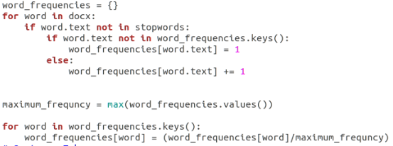
Continuation
Code to calculate word frequencies.

Slide 21
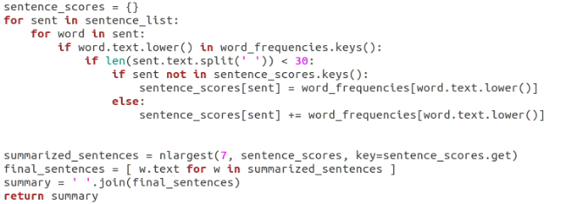
Continuation
Code to calculate sentence score.

Slide 22
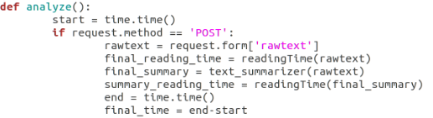

Continuation
Code to anaylze text from webpage and calculate elasped time.
Code to calculate reading time.

Slide 23
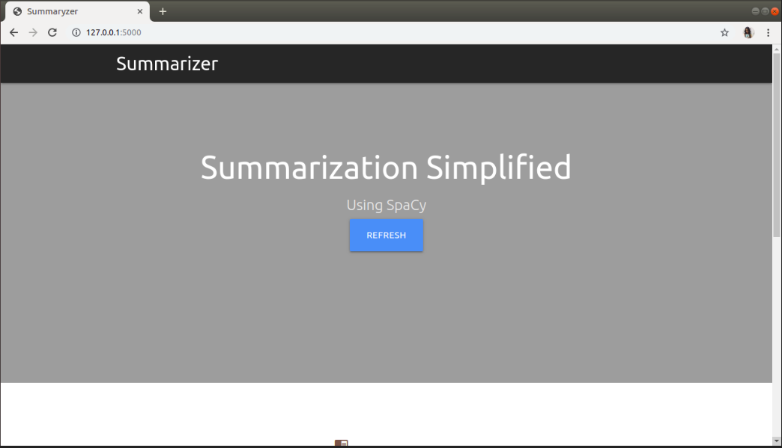
Header screen

Slide 24
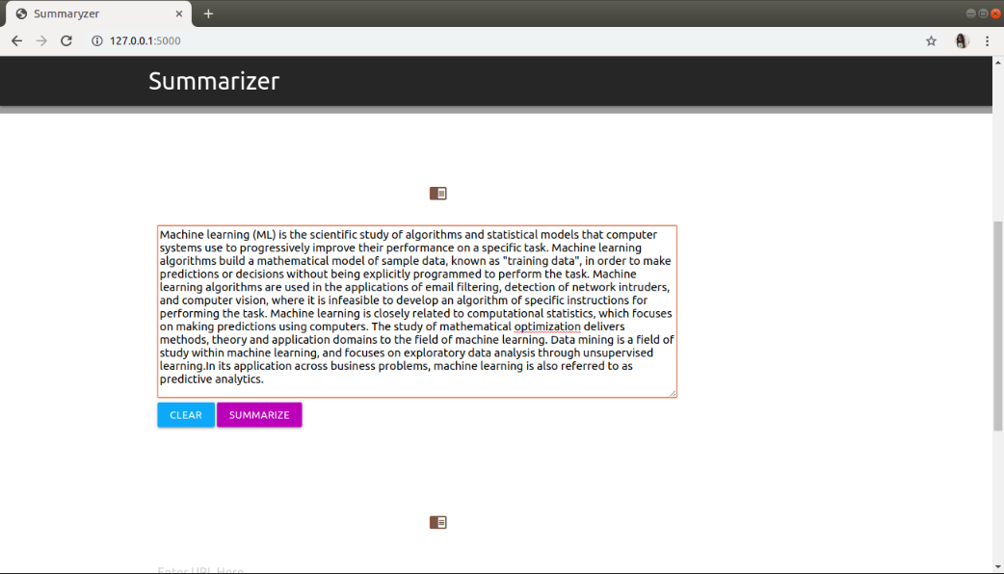
Text input

Slide 25
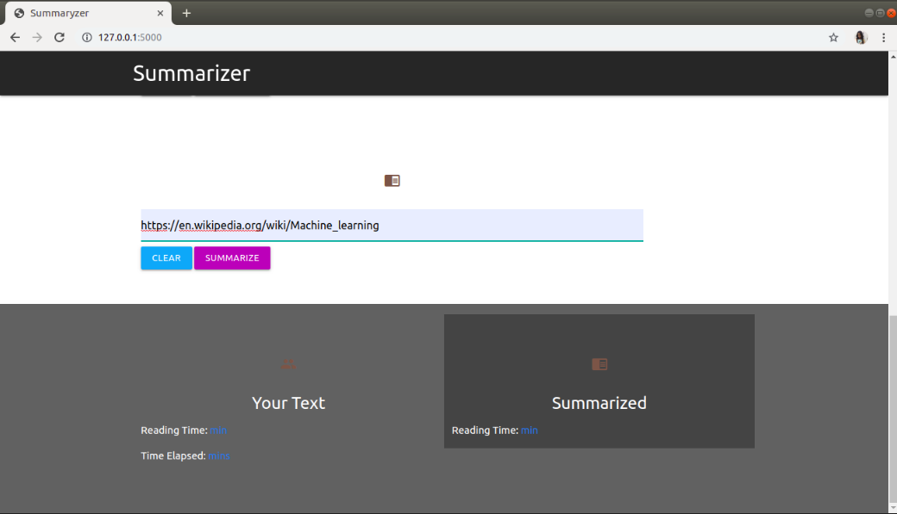
url input

Slide 26
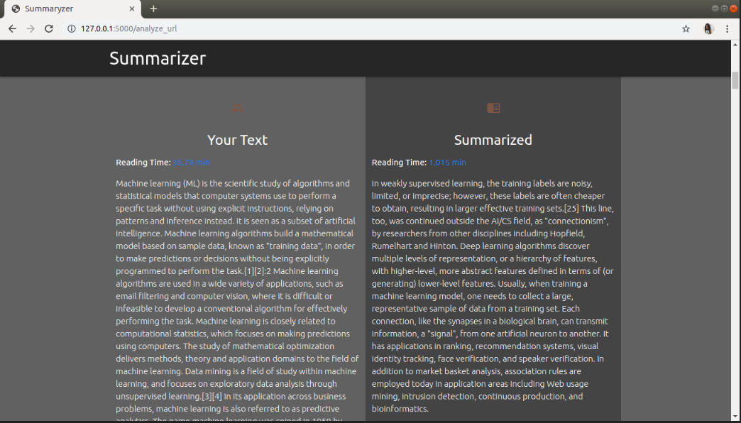
Result screen

Slide 27
references
Selvani Deepthi Kavila and Dr.Radhika Y, “Extractive Text Summarization Using Modified Weighing and Sentence Symmetric Feature”, I.J. Modern Education and Computer Science, October 2015.
Karel Jezek and Josef Steinberger, “Automatic Text summarization”, Vaclav Snasel (Ed.): Znalosti 2008, Ustav Informatiky a softveroveho inzinierstva, pp.1-12, 2008.
S.Mohamed Saleem, R.Krithiga, S.K.Rani, S.Celin Sindhya, “Study on text summarization using extractive methods”, International Journal of Science, Engineering and Technology Research (IJSETR), Volume 4, Issue 5, May 2015.

Slide 28
conclusion
In this new age, where massive amount of data is present digitally, it is essential to have a mechanism like Automatic Text Summarization in order to overcome the problem of information overload which has been growing rapidly. The process of text summarization summarizes the text with the help of Python NLTK library.

Slide 29

ANY QUERIES?

Slide 30


